Slide 1
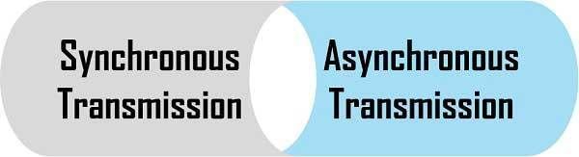
CSE360-Computer Interfacing BRAC University

Slide 2
Synchronous Transmission
In Synchronous the transmission of data is sent in a continuous stream at a constant rate.
Synchronous communication requires that the clocks in the transmitting and receiving devices are synchronized running at the same rate.
Data flows in a full duplex mode in the form of blocks or frames.
Synchronous Transmission is efficient, reliable and is used for transferring a large amount of data.

Slide 3
Synchronous Transmission
.
The data is sent in blocks (called frames or packets) spaced by fixed time intervals.
The data blocks are grouped and spaced in regular intervals and are preceded by special characters called “sync” or “synchronous” idle characters. See the following illustration:
After the ”syn” characters are received by the remote device, they are decoded and used to synchronize the connection. After the connection is correctly synchronized, data transmission may begin.

Slide 4



Synchronous Transmission
Most network protocols (such as Ethernet, SONET, Token Ring) use synchronous transmission.
Examples:
Chat Rooms
Video Conferencing / Calling
Telephone Conversations

Slide 5
Asynchronous Transmission
In contrast, asynchronous transmission works in spurts and must insert a start bit before each data character and a stop bit at its termination to inform the receiver where it begins and ends.
The term asynchronous is used to describe the process where transmitted data is encoded with start and stop bits, specifying the beginning and end of each character.
Data flows in a half-duplex mode, 1 byte or a character at a time.
This method of transmission is used when data are sent from time to time or occasionally.

Slide 6
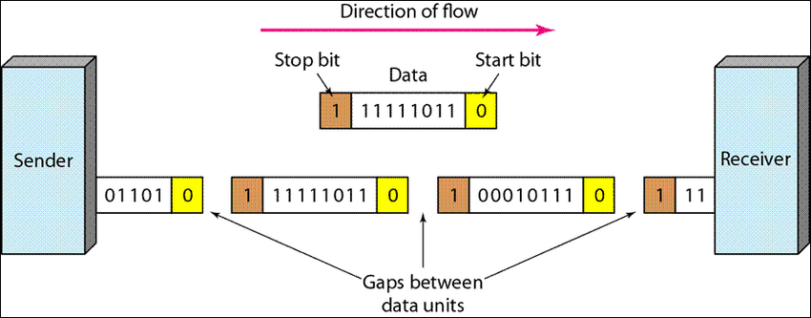
Asynchronous Transmission
.
See the following illustration:
So to send 1 byte data or 8 bit data, we have to actually send 10 bits data or sometime 11 bits data.

Slide 7
Asynchronous Transmission
.
These additional bits provide the timing or synchronization for the connection by indicating when a complete character has been sent or received; thus, timing for each character begins with the start bit and ends with the stop bit.
When gaps appear between character transmissions, the asynchronous line is said to be in a mark state. A mark is a binary 1 (or negative voltage) that is sent during periods of inactivity on the line.
When the mark state is interrupted by a positive voltage (a binary 0), the receiving system knows that data characters are going to follow.

Slide 8
Asynchronous Transmission
.
It is for this reason that the start bit, which precedes the data character, is always a space bit (binary 0) and that the stop bit, which signals the end of a character, is always a mark bit (binary 1).
For extra bits of synchronization, there is overhead, which reduces its speed
Asynchronous is simple, economical and used for transmitting a small amount of data
Examples: Letters Radios Email Televisions

Slide 9
.
BASIS FOR COMPARISON | SYNCHRONOUS TRANSMISSION | ASYNCHRONOUS TRANSMISSION
Meaning | Transmission starts with the block header which holds a sequence of bits. | It uses start bit and stop bit preceding and following a character respectively.
Transmission manner | Sends data in the form of blocks or frames (Full Duplex) | Sends 1 byte or character at a time (Half Duplex)
Synchronization | Present with the same clock pulse. | Absent
Transmission Speed | Fast | Slow
Gap between the data | Does not exist | Exist
Cost | Expensive | Economical
Time Interval | Constant | Random
Meaning | Transmission starts with the block header which holds a sequence of bits. | It uses start bit and stop bit preceding and following a character respectively.
Transmission manner | Sends data in the form of blocks or frames | Sends 1 byte or character at a time

Slide 10
.
Thank You For Your Attention

